Slide 1
Design for Verification Project Update
2021-09-27
Eldrick Millares (eldrick@stanford.edu)

Slide 2
Recap:
Adding all of RISC-V RV32I ISA to instructions being tested
Deploying on CVA6 (Ariane)
Deploying “External QED” to Steelcore

Slide 3
Added all 40 RV32I Instructions
New RISC-V Instructions which were missing before in our SQED tests:
Jumps (JAL, JALR)
Load Variants (LB, LH, LBU, LHU)
Misc Control Flow: LUI, AUIPC
Store Variants (SB, SH)
Branches (BEQ, BNE, BLT, BGE, BLT], BGEU)
System Instructions: ECALL, EBREAK
Memory Ordering: FENCE

Slide 4
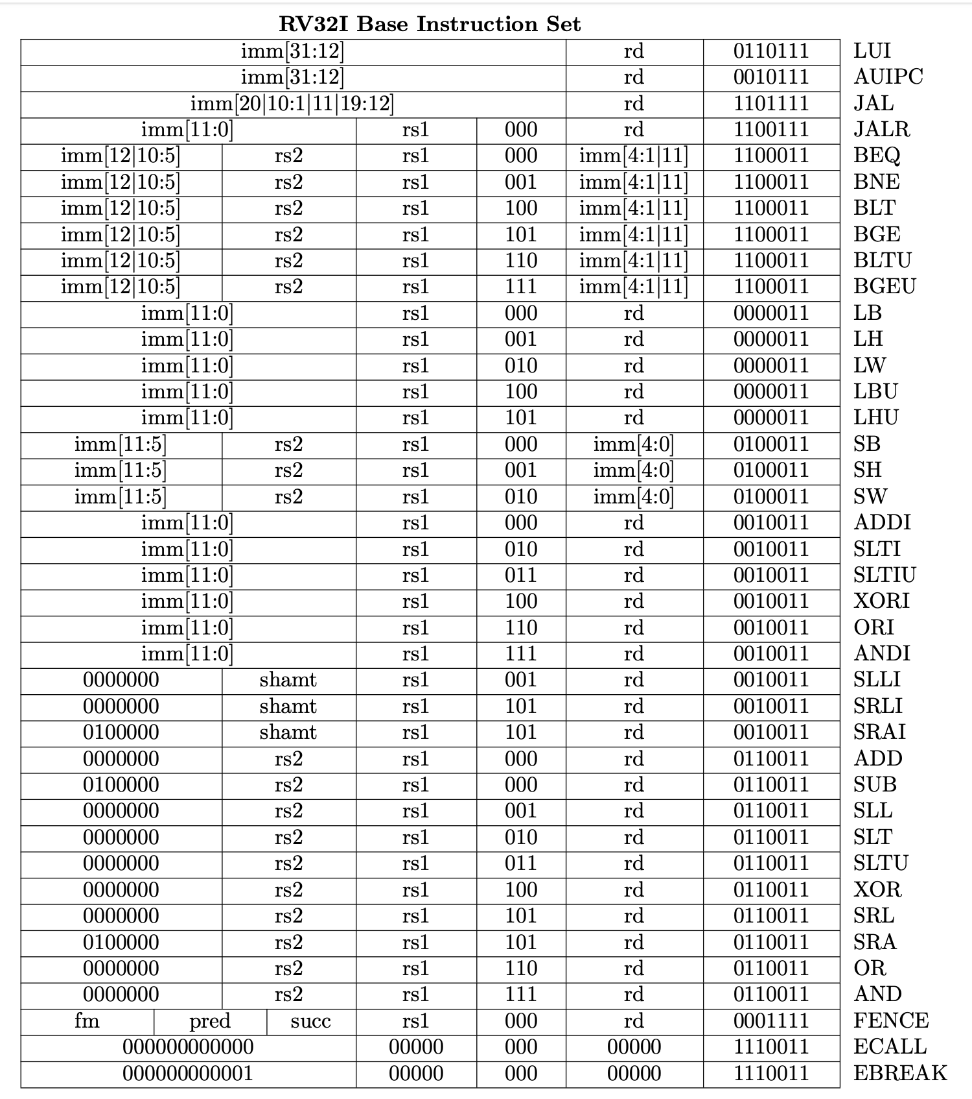

Slide 5
Added all 40 RV32I Instructions
New RISC-V Instructions which were missing before in our SQED tests:
Jumps (JAL, JALR)
Load Variants (LB, LH, LBU, LHU)
Misc Control Flow: LUI, AUIPC
Store Variants (SB, SH)
Branches (BEQ, BNE, BLT, BGE, BLT], BGEU)
System Instructions: ECALL, EBREAK
Memory Ordering: FENCE
Created new RV32I format file for sqed-generator
Reusable for future projects

Slide 6
Results: Testing all of RV32I on Steelcore
No new counterexamples found except for PC-dependent instructions (recap on next slide)
7 hours run time so far Proof depth: 6 10GB RAM Usage

Slide 7
Recap: PC-Dependent Instructions
JAL / JALR / AUIPC instructions in RISC-V are not functionally consistent
JAL (Jump and Link) JALR (Jump and Link Register) AUIPC (Add Upper Immediate to PC)
All three instructions store state of PC into a register $rd
Immediate + PC -> $rd
Workaround: Constrain $rd === $r0

Slide 8
Next Steps: CVA6
Started deploying to CVA6 (RV64IMAC, 6 stage, Linux Bootable, more complex uarch) 3rd most popular RISC-V core by # of Github Stars
Project structure changed 3 days ago to separate the core from FPGA-specific implementation dependencies.

Slide 9
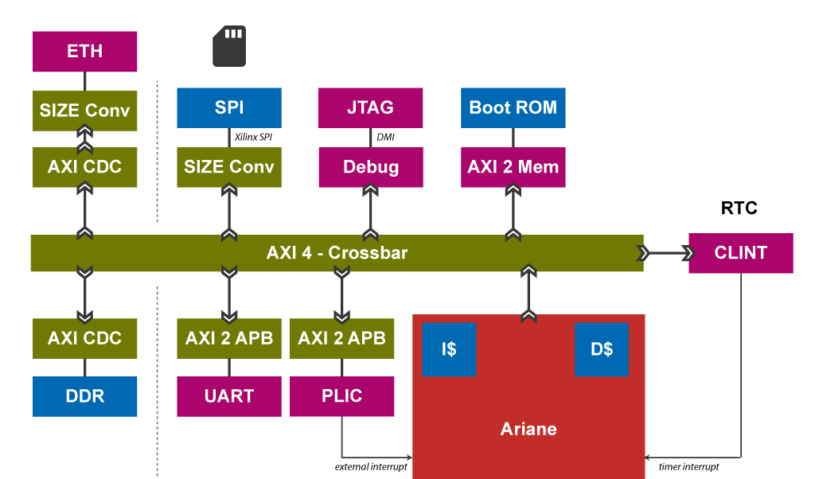
Next Steps: CVA6
Step 1: Create a simplified system with core + memory

Slide 10
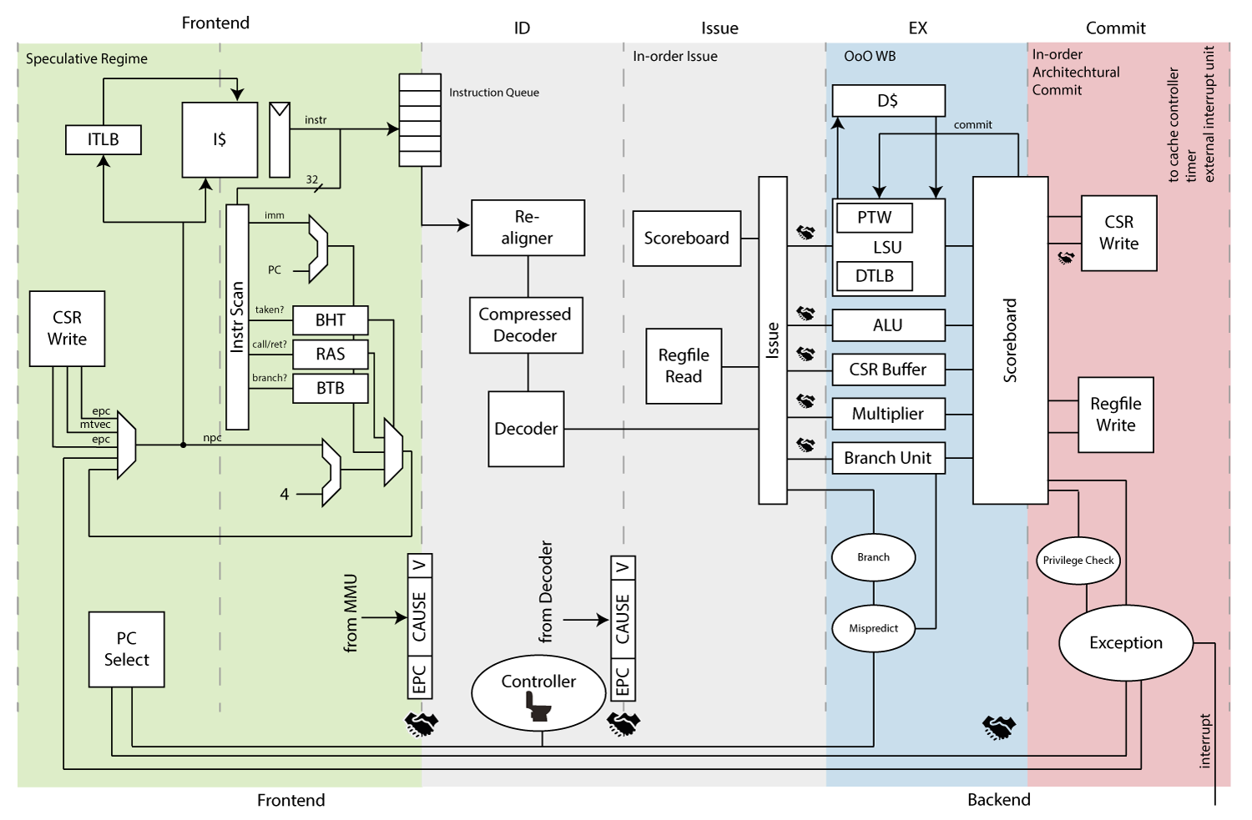
Next Steps: CVA6
Step 2: Add QED Module, commit tracking logic, and constraints to core

Slide 11
Next Steps: CVA6
Step 3: Account for new uarch blocks (scoreboard, BTB, etc)

Slide 12
Next Steps: CVA6
Step 4: Run SQED + SSS with RV32I Instructions Only
Step 5: Add RV64IMAC Instructions
64b
MUL instructions
Atomics
Compressed instructions

Slide 13
Next Steps: CVA6
Aiming to complete Step 1 by end of week
Requires navigating new project structure + connecting AXI agents by hand

Slide 14
Recap: External QED - Progress
Implemented “memory shim” and integrated into design (steelcore)
No control flow - only arithmetic, memory load/store
Changes from original QED so far:
Instantiated separate instruction memory
Added in initial “boot address” constraint for PC
Extended Tc later to account for initial fetch cycles, longer pipeline

Slide 15
Recap: External QED - Issues
Implementation still ongoing
Current Issues:
Duplicate instructions not being issued
Much longer proof bounds
Previous: Hours for 3-6 instructions
External QED: Jumps from 4 to 16 to 18 within minutes

Slide 16
Next Steps: External QED
Need to debug external QED duplicate instruction issue
Next priority after CVA6 system instantiation finished

